Slide 1



fullstackdatascience.com
Lesson 17 - Advanced BI
Created by Huydata
DA K6
Lesson 3
huynt@fullstackdatascience.com
1

Slide 2

Learn
About
01/
Machine Learning in BI
02/
Generative AI
03/
Dashboard Visualization
fullstackdatascience.com
2

Slide 3
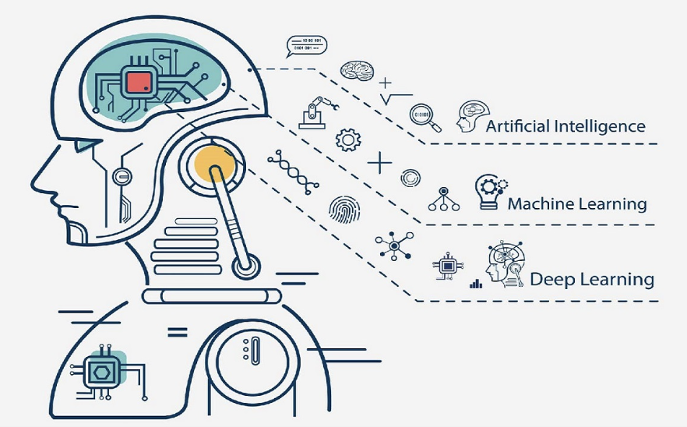
Machine Learning
In BI
Machine learning (ML) is a field of artificial intelligence (AI) that focuses on enabling computers to learn from data without being explicitly programmed.
3

Slide 4

House Prediction
5

Slide 5

Titanic Prediction
5

Slide 6

Generative AI
3

Slide 7
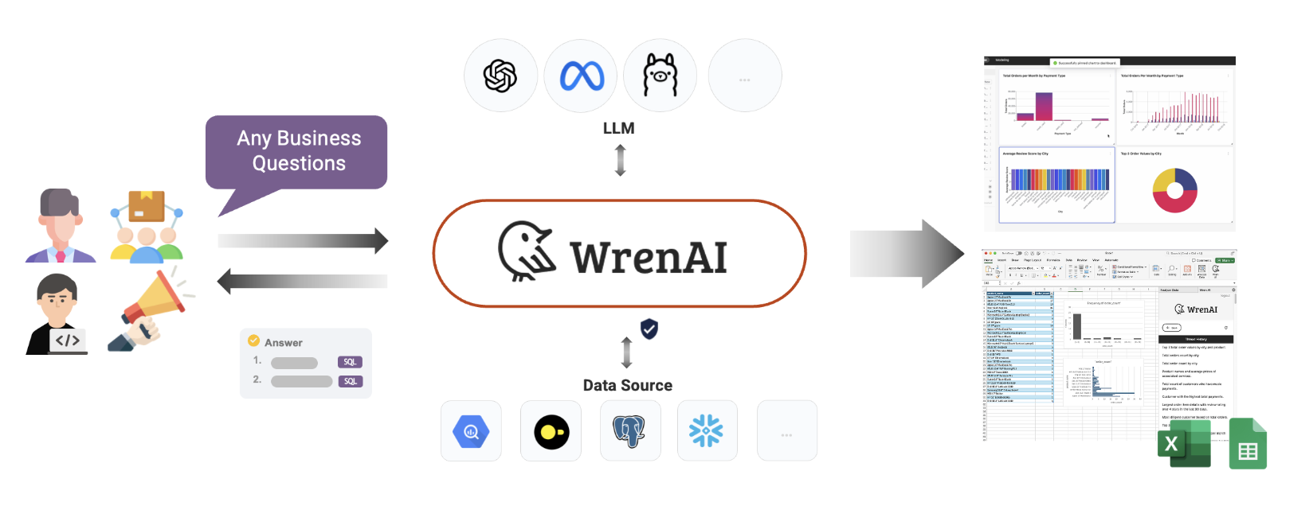
Wren AI
4

Slide 8
ChatGPT
QUESTION - ANSWER
4

Slide 9
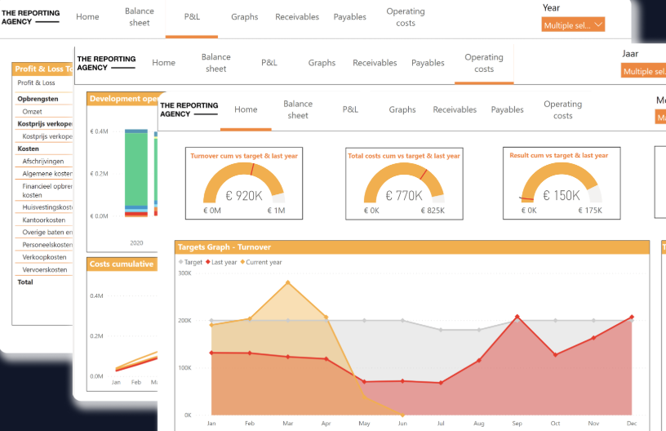
Dashboard
Visualization
3

Slide 10

Flow
4

Slide 11

Grid System
4

Slide 12
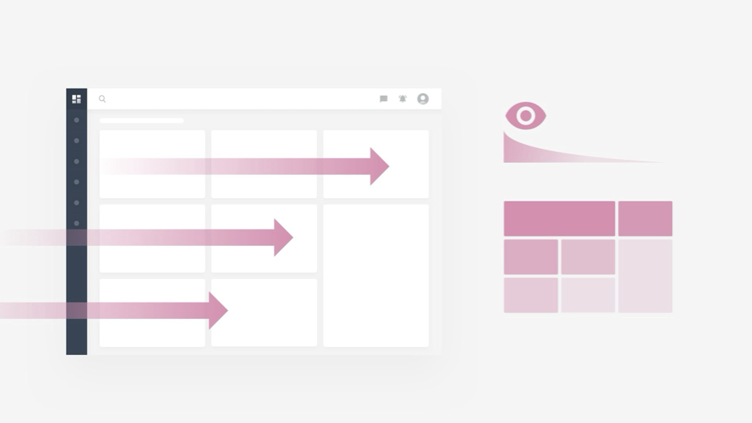
Scanning Flow
4

Slide 13
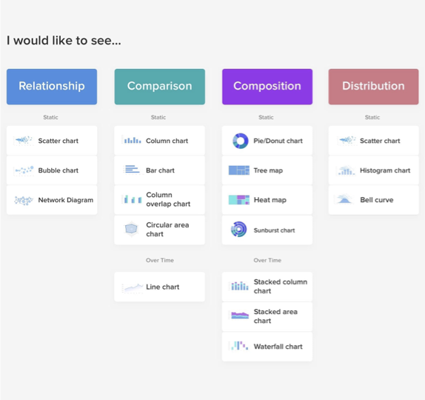
Choose the right chart
4

Slide 14
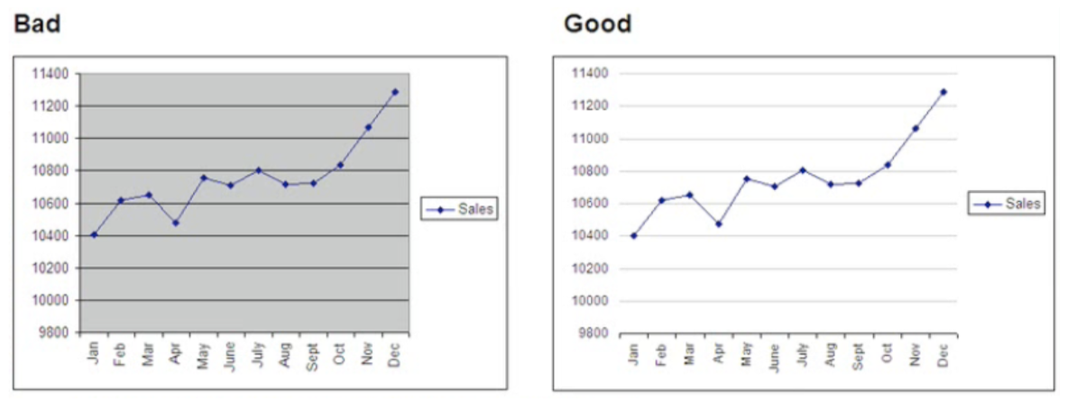
Choose the right chart
4

Slide 15
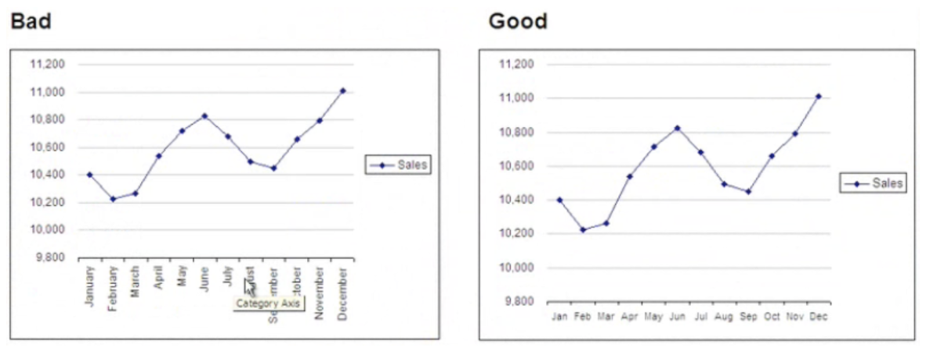
Choose the right chart
4

Slide 16
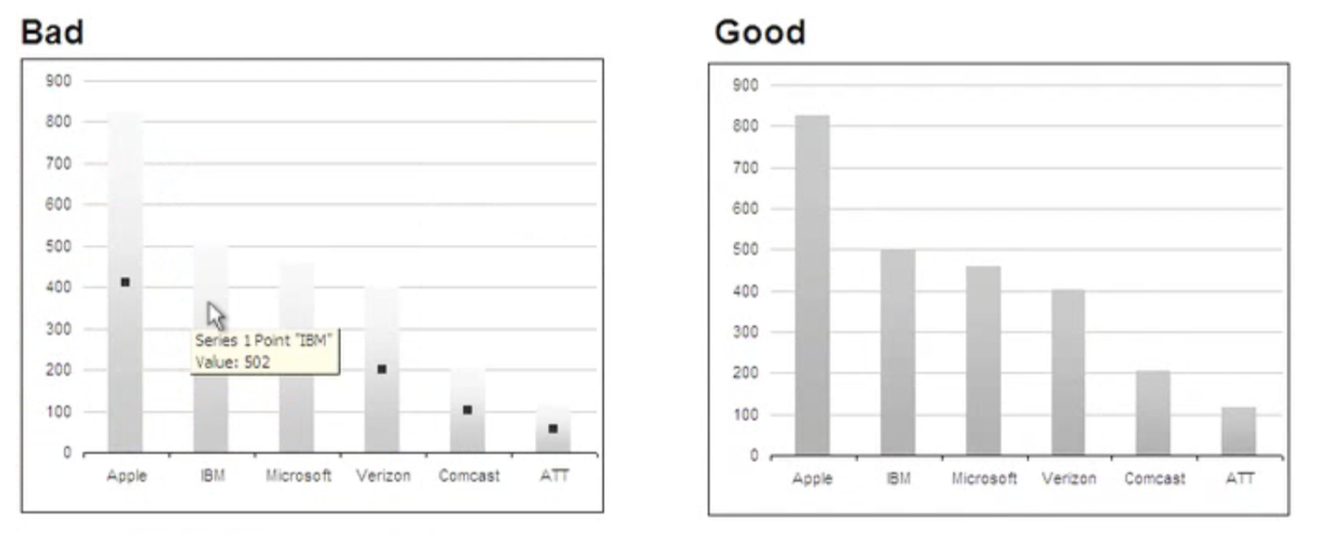
Choose the right chart
4

Slide 17
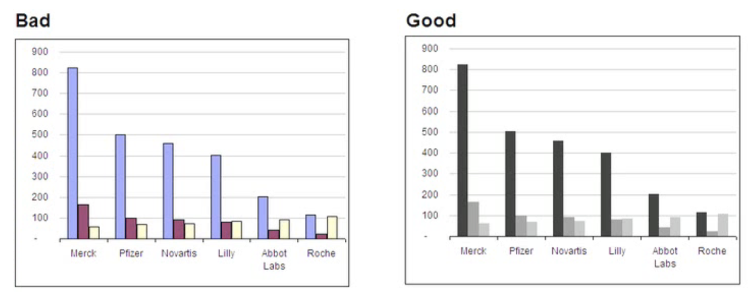
Choose the right chart
4

Slide 18
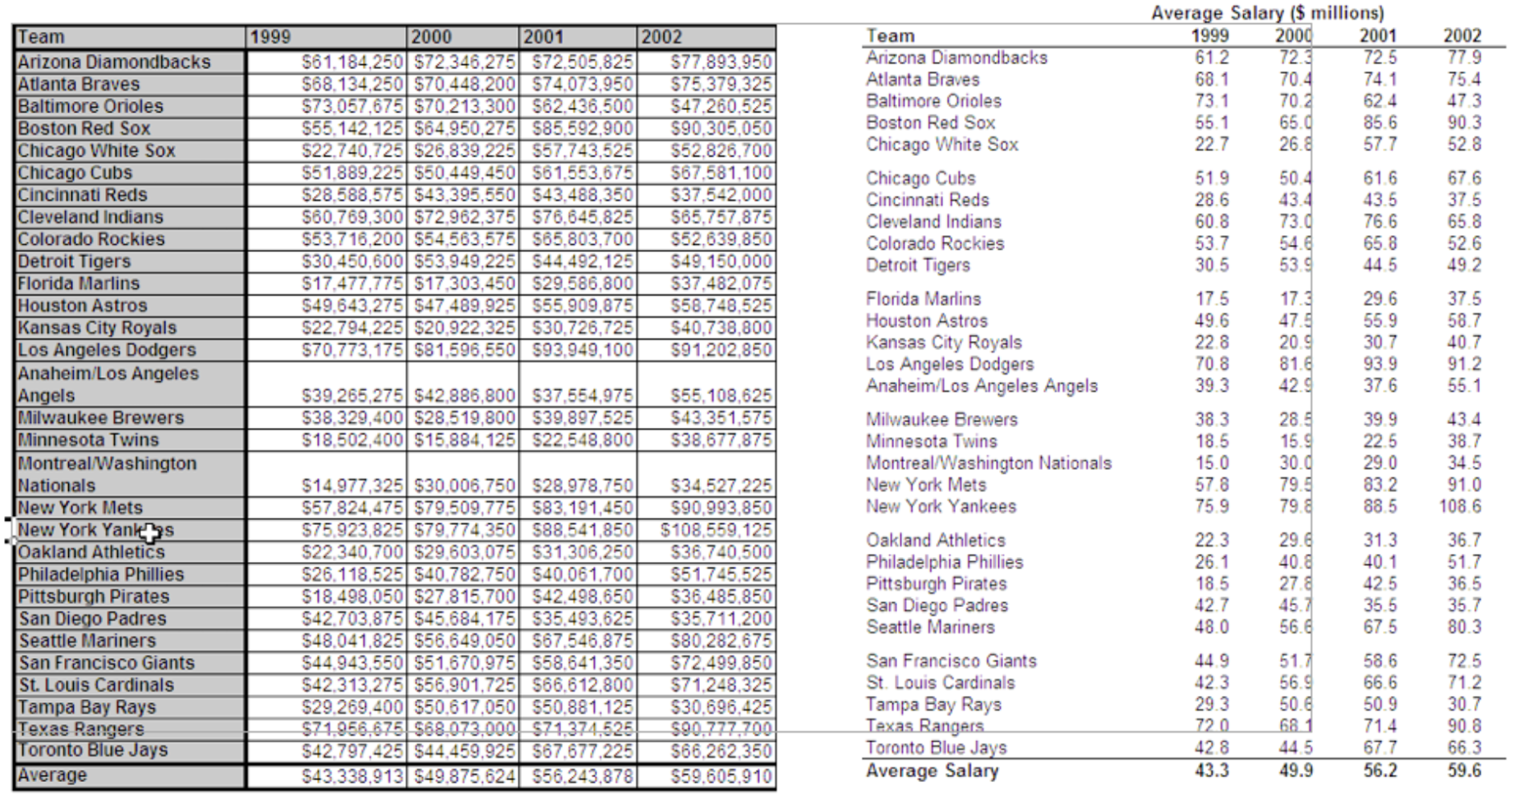
Choose the right chart
4

Slide 19

fullstackdatascience.com
References
11

Slide 20





Thank you
096 574 90 25
CREATED BY
Nguyen Tien Huy
info@robusto.ai
fullstackdatascience
huynt@fullstackdatascience.com
Data Manager
https://fullstackdatascience.com/
Hanoi, Vietnam

